Slide 1
Tutorial 1: Debug and printf

Slide 2
Tutorial Tasks
By now, you should have successfully set up your C programming environment (VSCode + gcc).
If not, please contact TA during the tutorial and ask for help.
During the lab, we have seen how to compile and run a C program via command line:
gcc main.c -o main.exe
./main.exe
In this tutorial, let us look at another important feature of VSCode: run & debug.

Slide 3
“Bug”
People refer to programming error/software defects as “bugs”.
“There is a bug in your program.”
Hence, “de-bug” means finding and eliminating errors in a program.

Slide 4
Debugger
However, the computer executes our programs extremely fast, making it difficult to check the validity of some complex programs.
Debugger is a software that enables you to trace the execution of your program step by step, and monitor the key variables of your program.

Slide 5
Debugger
Usually, a debugger allows you to:
Execute your program to a specific point and stop
Execute your program step by step
Track changes in computational resources (such as memory or IO device status).
One popular debugger is called gdb (GNU debugger), which is often used together with gcc.
gdb itself is a command line software, like gcc. However, VSCode allows us to use gdb from a graphical interface.

Slide 6
Start Debugger
Open the folder that contains the lab file (“main.c”), click and open main.c from the left pane.
To trigger the debugger, simply press F5.
If VSCode prompts you to “install the C++ extension” first, please do so. If it does not, you are fine.
Or, you can click the menu “run”, then “start debugging”.
Your program should automatically compile and run.

Slide 7
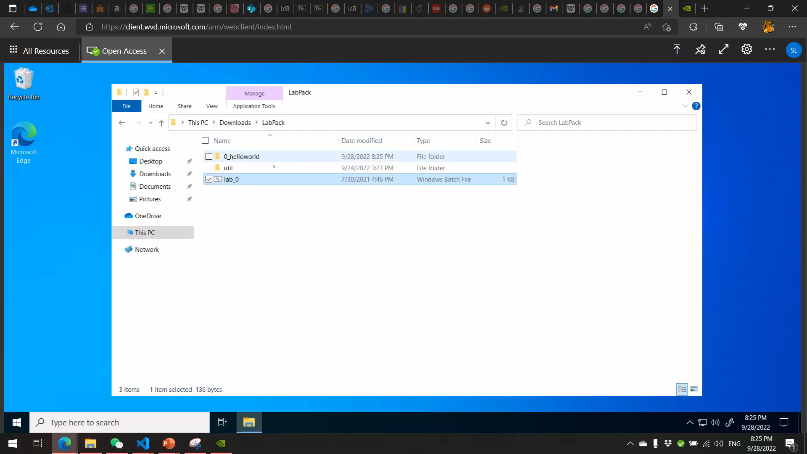
Watch the video below:
Click “terminal” pane to see the output of your program.

Slide 8
Breakpoint.
You can stop your program at a breakpoint and execute your code step by step:
First, click on the left edge of your editor on the line you want the debugger to stop to create a breakpoint.
Second, run the debugger. your program should automatically start and stop at the line you have indicated.
Third, press F10 to “step over” the current line.
Finally, when you are done with debugging, press “F5” to resume the execution.

Slide 9
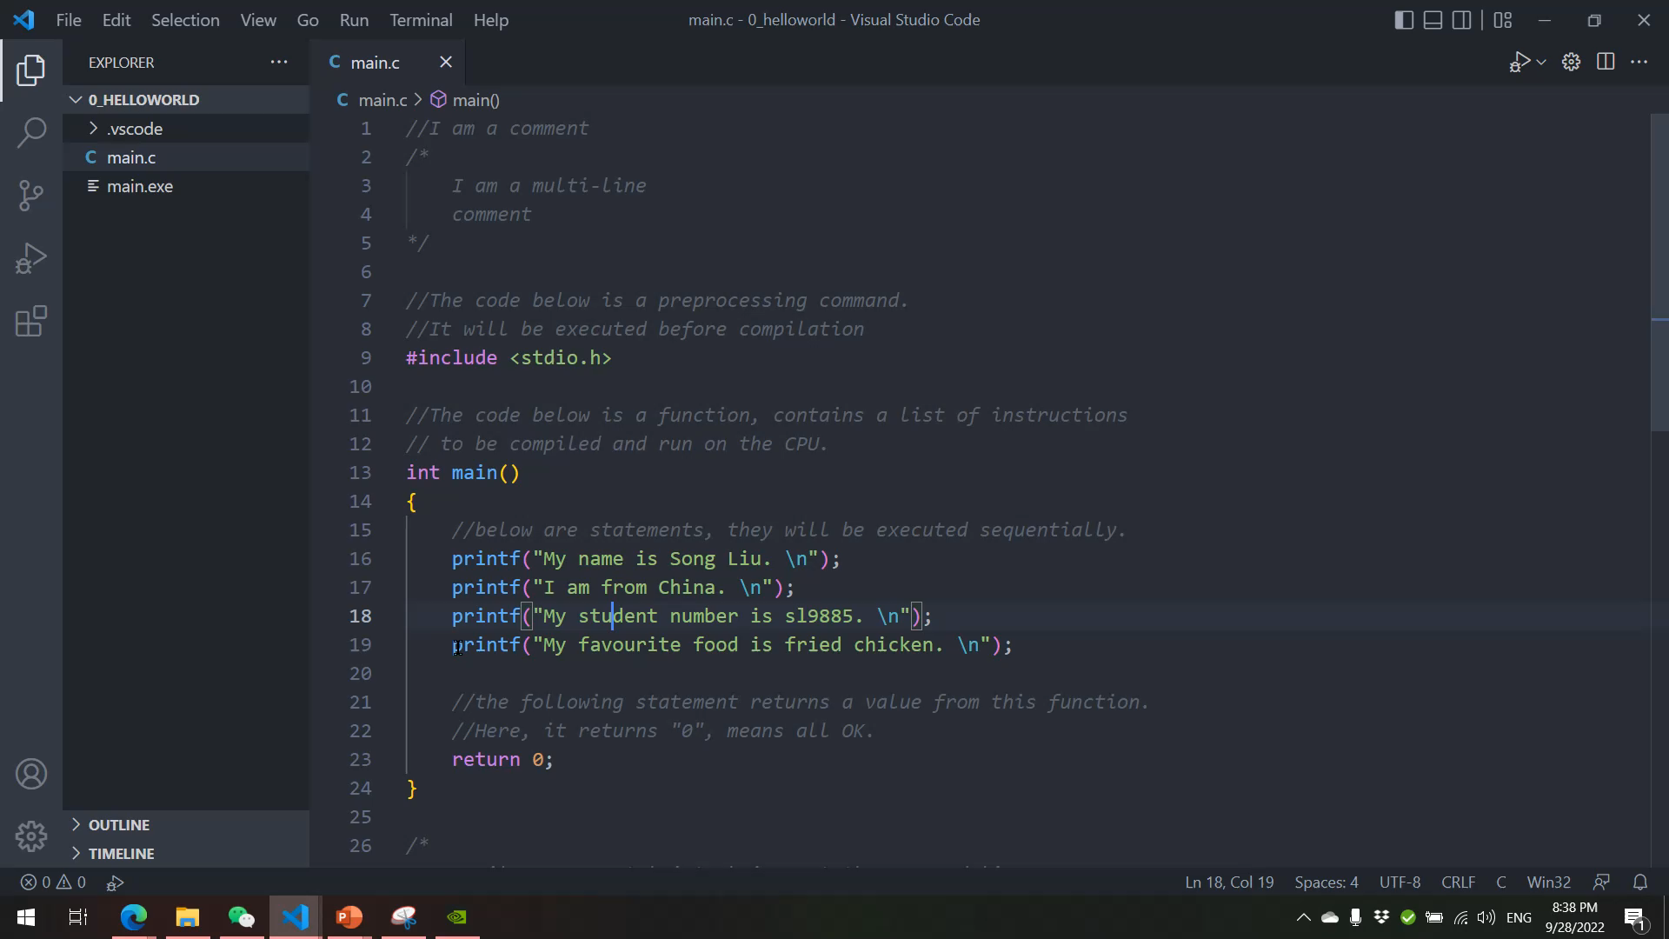
Watch the video below:
Watch how the output is produced line by line as you press F10!

Slide 10
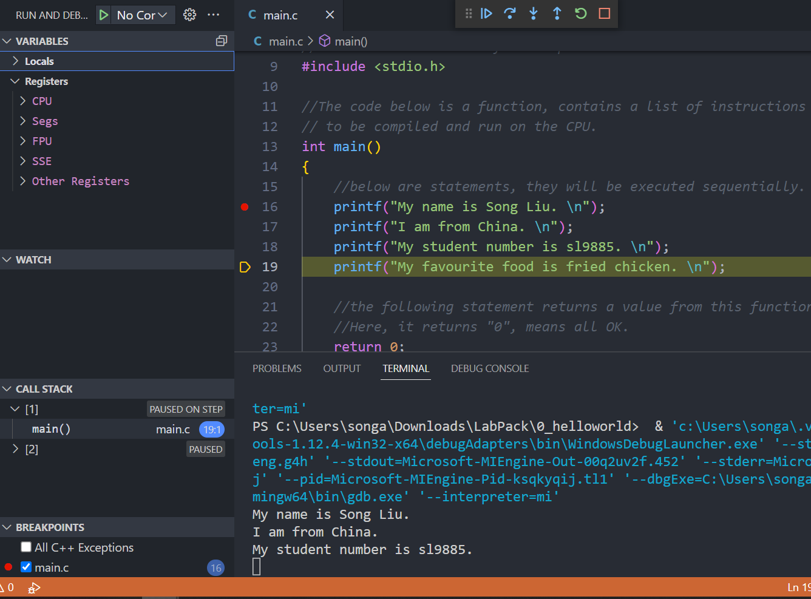
On the left pane, you can monitor the change in computational resources as our program runs.
We will talk about these in future lectures.

Slide 11
printf
Builtin function “printf” displays "format string".
This function is provided by the OS and is declared in file “stdio.h”.
Hence the preprocessing command: “#include<stdio.h>”
In the lab, we have used printf to produce command line output.
printf function can do a lot more than just printing out text messages.

Slide 12
printf
Usage:
printf("FORMAT_STRING", VARIABLE1,VARIABLE2 ...);
Format string contains "format specifiers".
“printf” will replace all "format specifiers" in the “FORMAT_STRING” with supplied “VARIABLE” before display.
printf("My name is %s %s. \n", "Song", "Liu")
Prints out “My name is Song Liu.”
"%s": string specifier, tells computer to expect "string" type variable at this location.
"\n": ASCII code for "new line".

Slide 13
printf
There are other format specifiers:
“%s”: String format specifier.
“%f”: Decimal number format specifier
“%.5f”: Decimal number with 5 digits after “.”
“%d”: integer format specifier.
“%c”: single character
“\*”: where * stands for special commands.
“\n”: Change line

Slide 14
printf (1)
Add additional “printf statements” to your week1 lab code so it will print out additional messages:
Print out your student ID (ab1234) as a string.
Print out your student ID (ab1234), treating the numeral part of your UoB ID as an integer.
Print out the outcome of 1/3 with 3 numbers after the decimal point.
Does it work? If not, why not?
Print out an emoji (😀)!

Slide 15
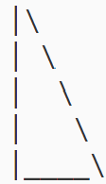
printf (2)
Add additional “printf” statements in the same file
Print out the following triangle using printf.
Hint: printf(“\\”) will print out “\”.
Similar to a past exam question.

